Slide 1







City Sakhi: Street Safety Heatmap
An innovative tool for enhancing nighttime safety in urban environments
Made By: Millee Mittal
Harshita Jain
Arpit Makkar
Ashima

Slide 2




Addressing Nighttime Safety Needs for Navigation
A safety-focused navigation tool is essential for community protection.
Nighttime streets can present hidden dangers for pedestrians.
Community-driven feedback enhances the effectiveness of safety maps.
Increased awareness can lead to safer walking routes at night.

Slide 3



Building a Community-Driven Safety Map
Our vision is to create a collaborative platform that empowers communities to contribute to a real-time safety map. By integrating user feedback and data, we aim to provide a comprehensive resource that highlights safe routes, addresses concerns, and ultimately fosters a sense of security for all residents, especially during nighttime.

Slide 4


Core MVP Features of City Sakhi
This section outlines the essential features designed to enhance community safety and improve navigation during nighttime hours.
Safety Indicators
User Feedback
Real-Time Alerts
Our app provides real-time safety indicators that highlight areas with increased risks based on user data and historical trends.
Users can report hazards and provide feedback, ensuring the map evolves and accurately reflects community safety concerns.
Users receive instant alerts about safety issues in their vicinity, allowing for better decision-making during nighttime navigation.

Slide 5
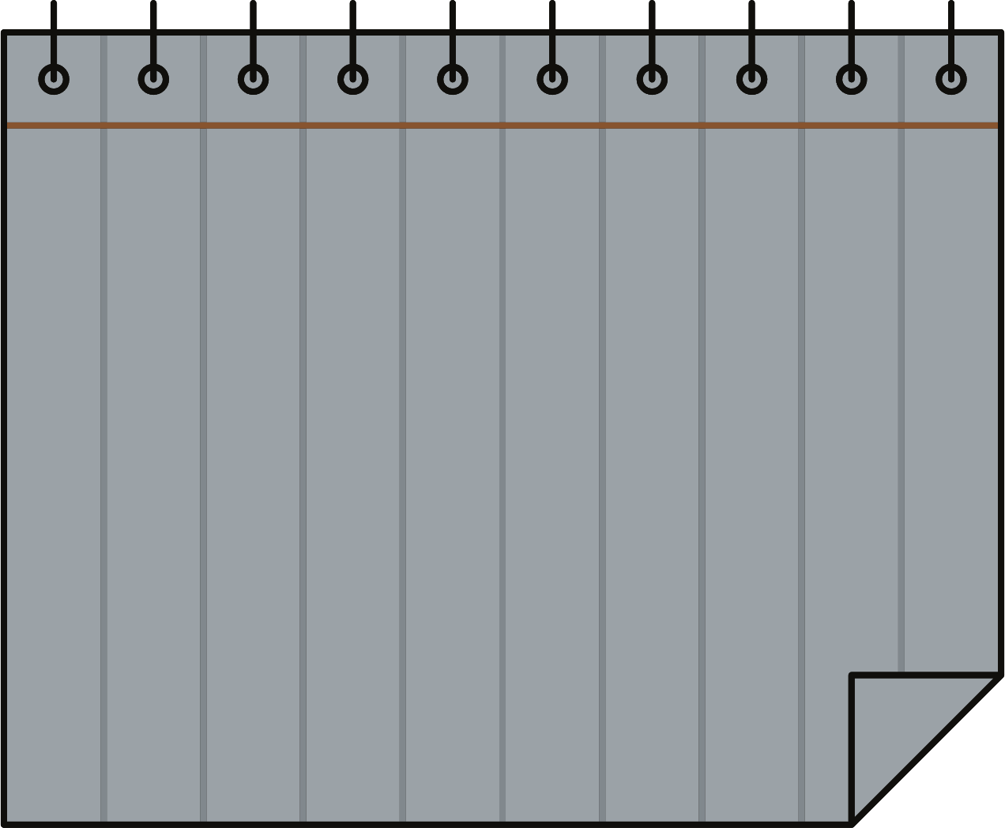

Feature Details of City Sakhi
Comprehensive Safety Ratings
User Contributions
Navigation Integration
Real-time Updates
Our platform provides detailed safety ratings for various routes based on real-time data, ensuring users make informed choices while navigating through the city at night.
Users can contribute by reporting incidents and safety concerns, enhancing the map's accuracy and community involvement. This creates a dynamic and responsive safety network.
The app seamlessly integrates with existing navigation tools, providing users with an easy-to-use interface while prioritizing safety throughout their journey.
Users receive real-time updates on safety conditions, ensuring they are always informed of any changes in their chosen route, making their travel experience safer.

Slide 6
Exploring Use Cases for City Sakhi
Enhance pedestrian safety in urban environments with real-time data.
Optimize event planning by identifying safe routes for attendees.
Foster community engagement through collaborative safety reporting.
Support local authorities in making data-driven safety improvements.

Slide 7




Key Advantages of City Sakhi for Communities
Promotes community empowerment by involving local voices in safety.
Enhanced safety awareness through real-time data and alerts.
Fosters collaboration between residents and authorities for improved safety.
Provides data-driven insights for informed navigation choices.

Slide 8
Exploring the Technology Stack for City Sakhi
Geographic Information Systems visualize routes and identify high-risk areas.
AI Algorithms analyze real-time data to predict safety challenges.
User-Friendly Interface ensures seamless navigation and accessibility for all users.
Community Feedback Integration enhances the map's accuracy and relevance over time.

Slide 9


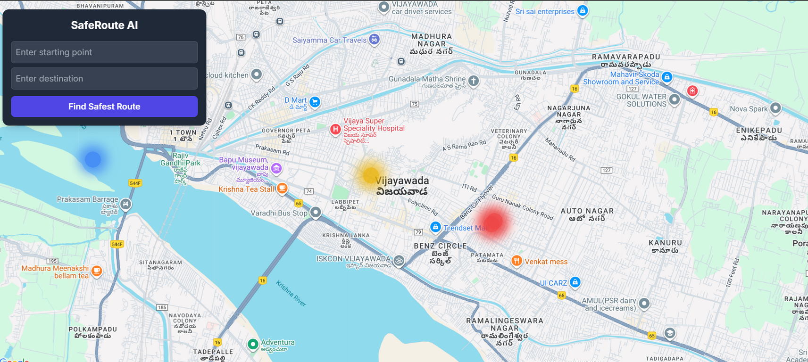

Hackathon Timeline: Day 1
On Day 1, our team will focus on the ideation and prototyping process for City Sakhi. We will brainstorm potential features, gather insights from participants, and create wireframes to outline the user interface. By the end of the day, we aim to have a solid prototype that highlights our key functionalities and addresses nighttime safety concerns effectively. Collaboration and feedback will be crucial as we evolve our ideas into tangible solutions.

Slide 10
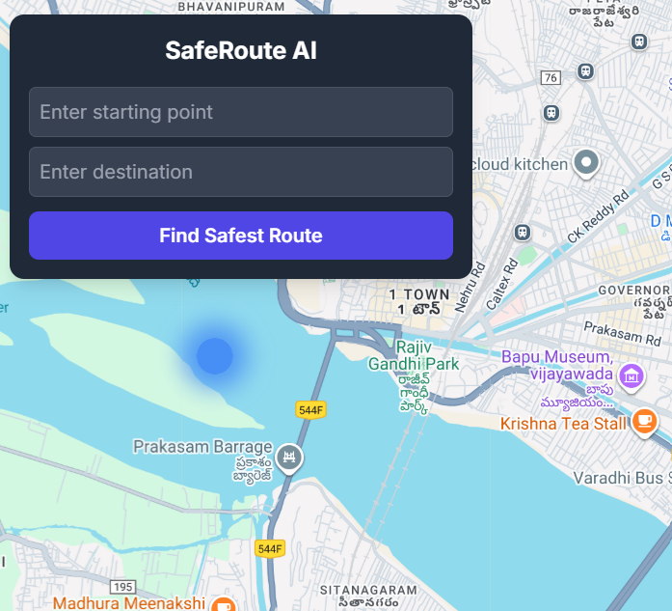
Hackathon Timeline - Day 2
On Day 2, our team will focus on the development and testing of the City Sakhi platform. We'll implement the core features, ensuring functionality and user experience are prioritized. Rigorous testing will be conducted to identify and resolve any bugs, while user feedback will be gathered to enhance the app's usability. Collaboration among team members will be crucial, enabling us to refine our solution and prepare for the final presentation.

Slide 11
Impact of City Sakhi
Improved Urban Safety
Community Trust
Empowered Citizens
Data-Driven Insights
By involving the community in data collection and sharing, City Sakhi fosters trust and collaboration. Citizens feel more connected to their neighborhoods, and the map becomes a reliable resource for everyone.
City Sakhi enhances nighttime safety by providing real-time data on safe and unsafe areas. This tool empowers citizens to make informed decisions about their routes and significantly reduces risks associated with nighttime travel.
City Sakhi enables citizens to take control of their safety by equipping them with valuable information. This empowerment leads to increased community participation and engagement in safety initiatives and urban planning.
The platform provides robust analytics that help city planners and organizations understand safety trends. This data-driven approach leads to targeted improvements in urban infrastructure and overall community safety.

Slide 12
Next Steps & Roadmap: Future Developments and Community Engagement Plans
Enhance user feedback mechanisms to improve app functionality and user experience.
Collaborate with local authorities to integrate real-time safety data into the platform.
Host community workshops to raise awareness and gather input on safety needs.
Develop partnerships with tech firms for advanced features and ongoing support.

Slide 13


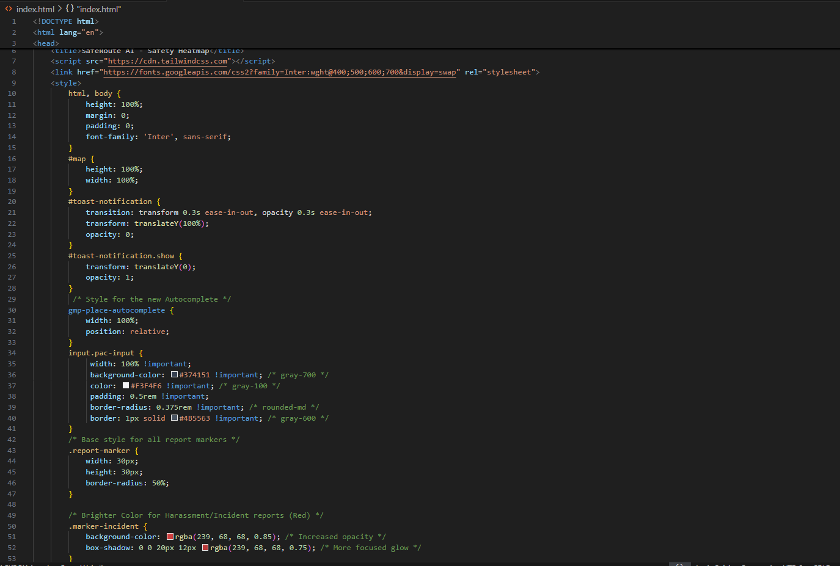
CODE

Slide 14
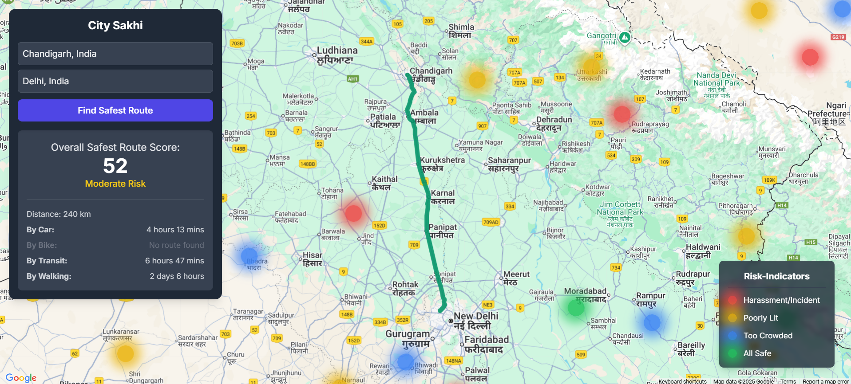
OUTPUT

Slide 15


Thank you for your support!

